Slide 1


Strengthening Communities, Families, and Practices using the Protective Factor Framework
June 7, 2022
10 AM-11:30 AM
Child Abuse Prevention Webinar Series Provided in Partnership by:

Slide 2
Objectives:
Gain an understanding of the Strengthening Families Framework: The Five Protective Factors and working in a strengths-based way.
Identify multiple strategies and everyday actions that help build Protective Factors.
Learn about resources, tools, and local implementation of the Protective Factors.
Reminder:
Please use the Questions button (and not the Chat) to submit any questions to the presenters. We will do our best to answer these at the end of the webinar.

Slide 3

Our Collaboration
Maine Children’s Trust was originally created by Statute in 1985 as a part of State Government. In 1994, legislation was enacted that transformed the Trust into a 501(c)3 non-profit governed by a Board of Directors. The Trust provides leadership and coordination of efforts throughout Maine to prevent child abuse and neglect before it occurs. The Trust provides funding and supports for prevention programming, as well as coordinates statewide collaborative initiatives to strengthen families. The Trust is also the state chapter for Prevent Child Abuse America.
The Department of Health and Human Services, Office of Child and Family Services contracts with Maine Children’s Trust to coordinate the Prevention Councils located in each county in Maine.

Slide 4
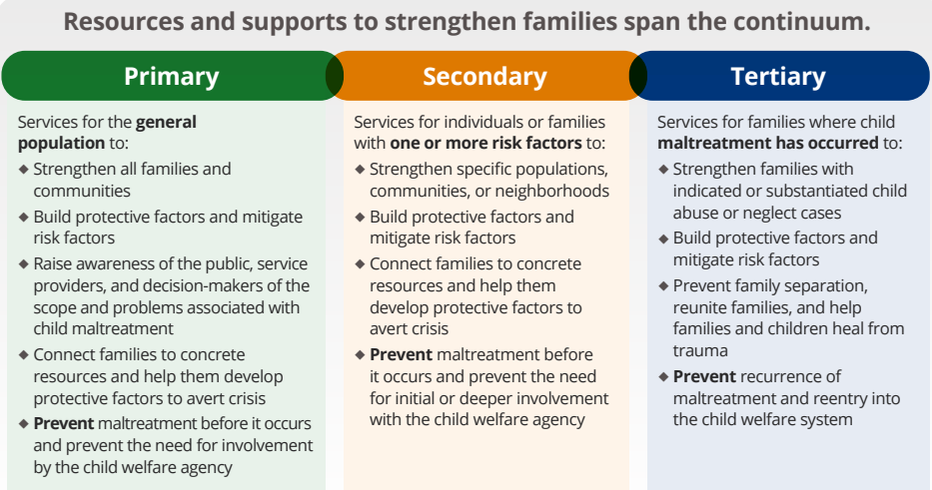
The Prevention Continuum
Media Messaging
Parent Education
Networks/Collaborations
Parent Education
Screening
Home Visiting Programs
Treatment and Recovery
Support Groups
Family Preservation Services
Capacity Building Center for States, 2021

Slide 5


Slide 6
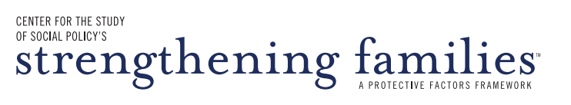
4
The Big Ideas
Behind the Protective Factor Framework for Strengthening Families
    Building protective and promotive factors, not just reducing risk
    An approach – not a model, a program or a curriculum
    A changed relationship with parents
    Aligning practice with developmental science

Slide 7
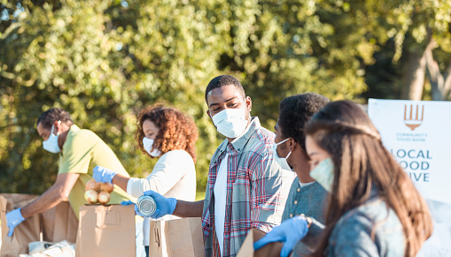



Big Idea #1
A Protective Factor Approach
Protective Factors: conditions or attributes of individuals, families, communities, or the larger society that mitigate or eliminate risk
Promotive Factors: conditions or attributes of individuals, families, communities, or the larger society that actively enhance well-being

Slide 8
Societal
(Policy)
Big Idea #1
Soci
Community
A Protective Factor Approach
Relationship
Protective Factors: conditions or attributes of individuals, families, communities, or the larger society that mitigate or eliminate risk
Promotive Factors: conditions or attributes of individuals, families, communities, or the larger society that actively enhance well-being
Individual

Slide 9



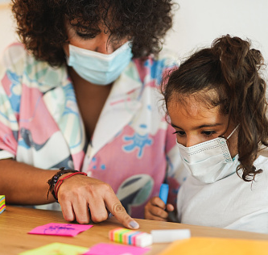
Big Idea # 2
An Approach, Not a Model
Research-based and evidence-informed
Applied in any setting that serves young children and their families
Implemented through small but significant changes
Not parallel to, but integrated into existing practice
Cross-sector implementation as core to the approach

Slide 10




Big Idea # 3
A Changed Relationship
with Parents
Engage parents as partners
Support and involve parents
Parents as leaders

Slide 11



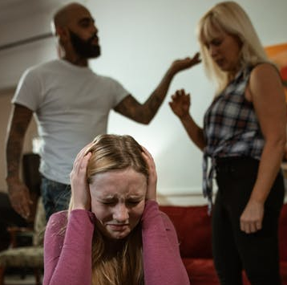
Big Idea # 4
Alignment with
Developmental Science
Research tells us to pay attention to:
  Critical periods of development – early childhood and adolescence
  Importance of nurturing relationships in early childhood
  Effects of trauma on development, behavior and outcomes

Slide 12
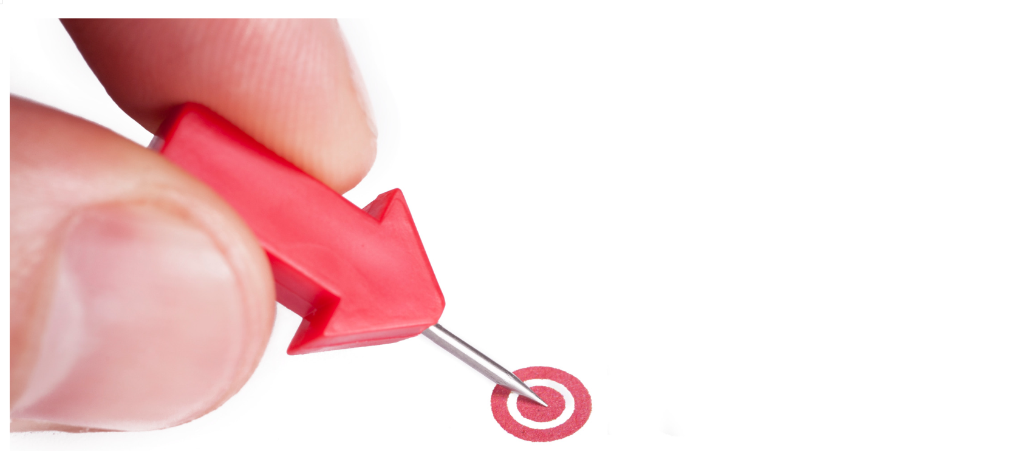
Small but significant changes

Slide 13
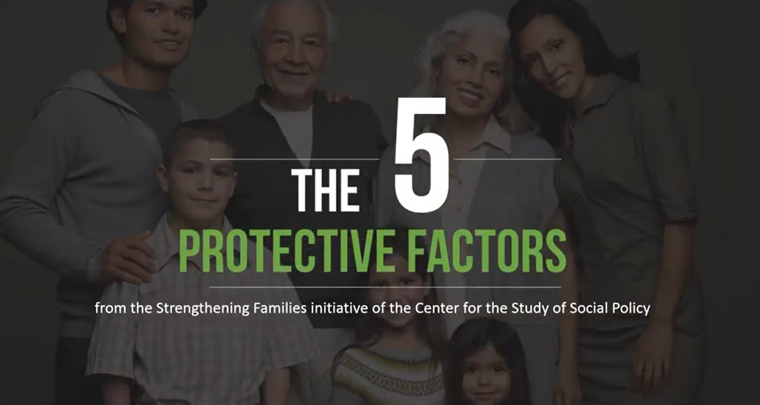

Slide 14


Slide 15
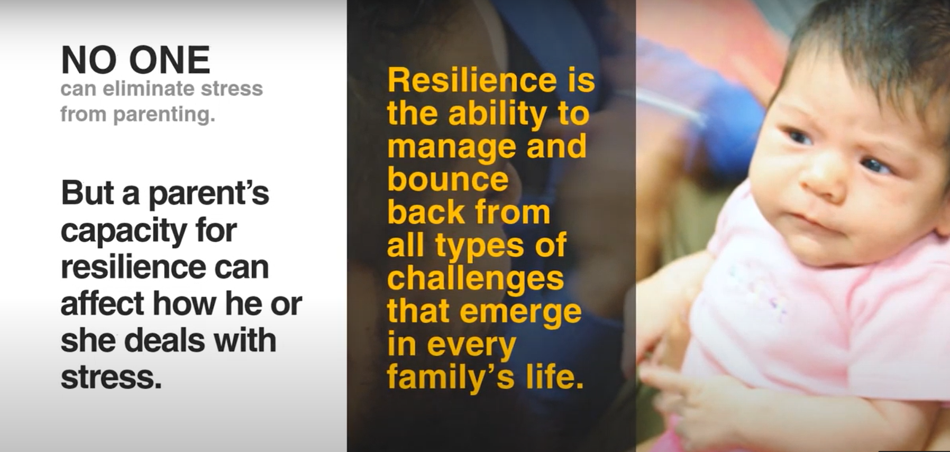

Slide 16
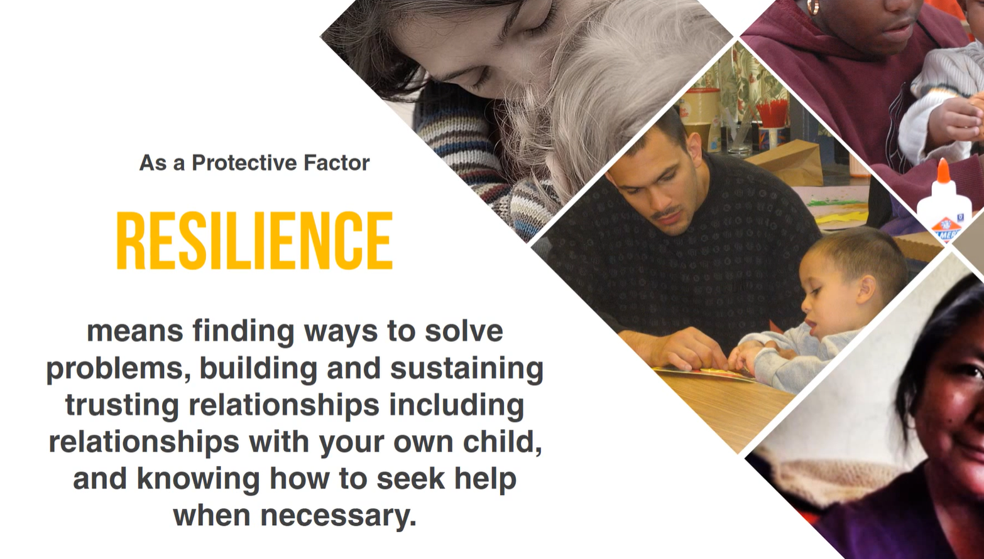

Slide 17
Parental Resilience
Everyday Actions
Demonstrate in multiple ways that parents are valued
Honor each family’s race, language, culture, history and approach to parenting
Encourage parents to manage stress effectively
Support parents as decision-makers and help build decision-making and leadership skills
Help parents understand how to buffer their child during stressful times

Slide 18
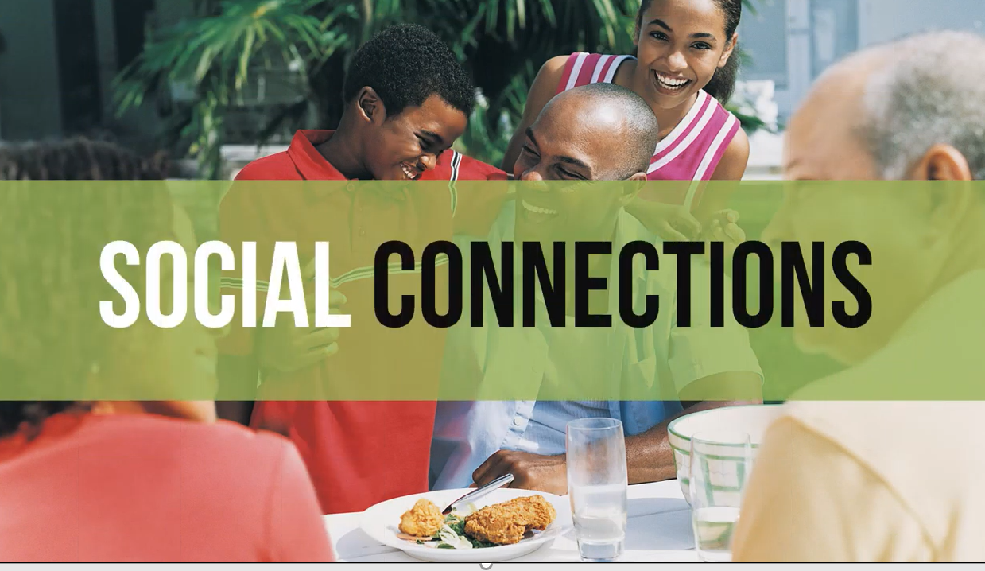

Slide 19
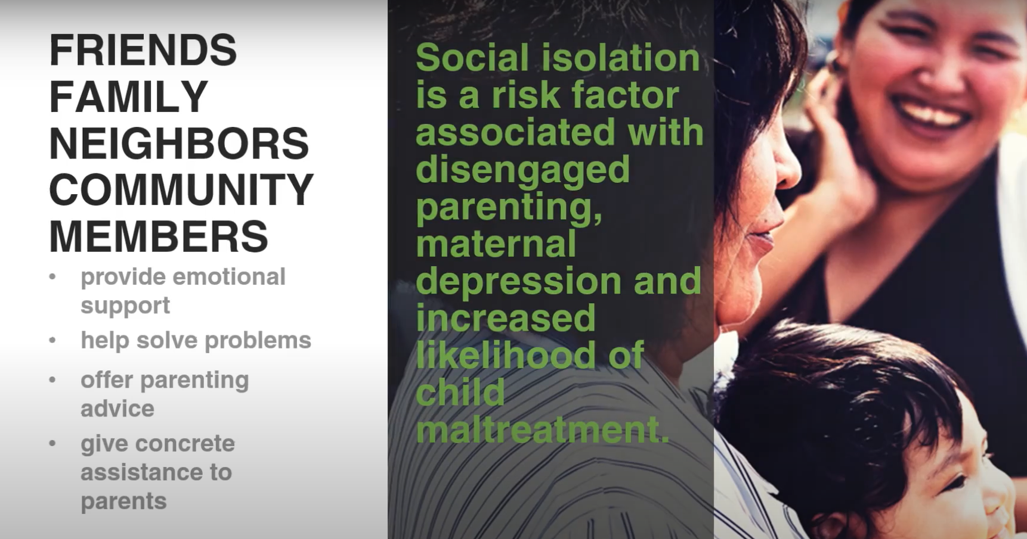

Slide 20
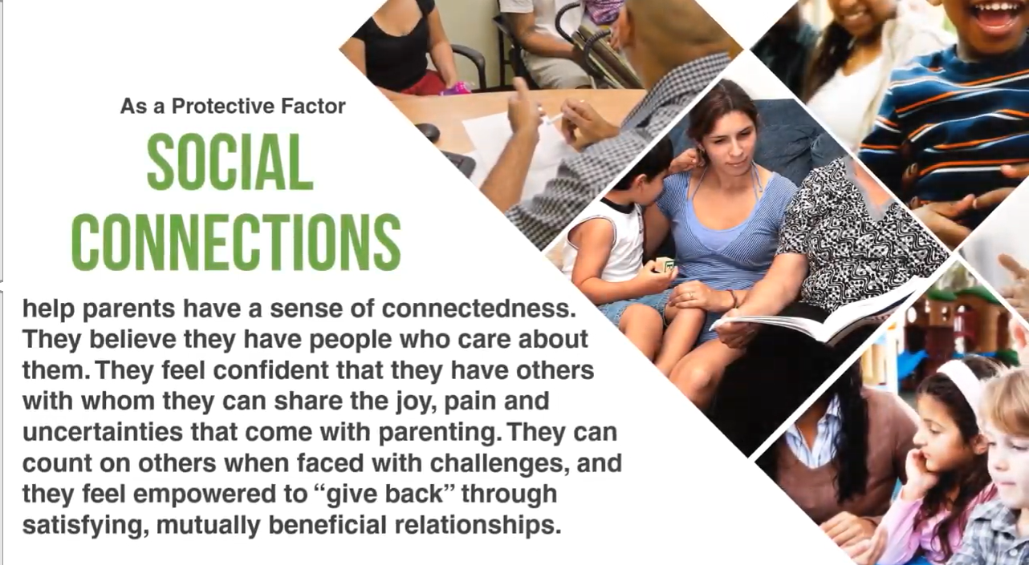

Slide 21
Social Connections
Everyday Actions
Help families value, build, sustain and use social connections
Create an inclusive environment
Facilitate mutual support
Promote engagement in the community and participation in community activities

Slide 22


Slide 23
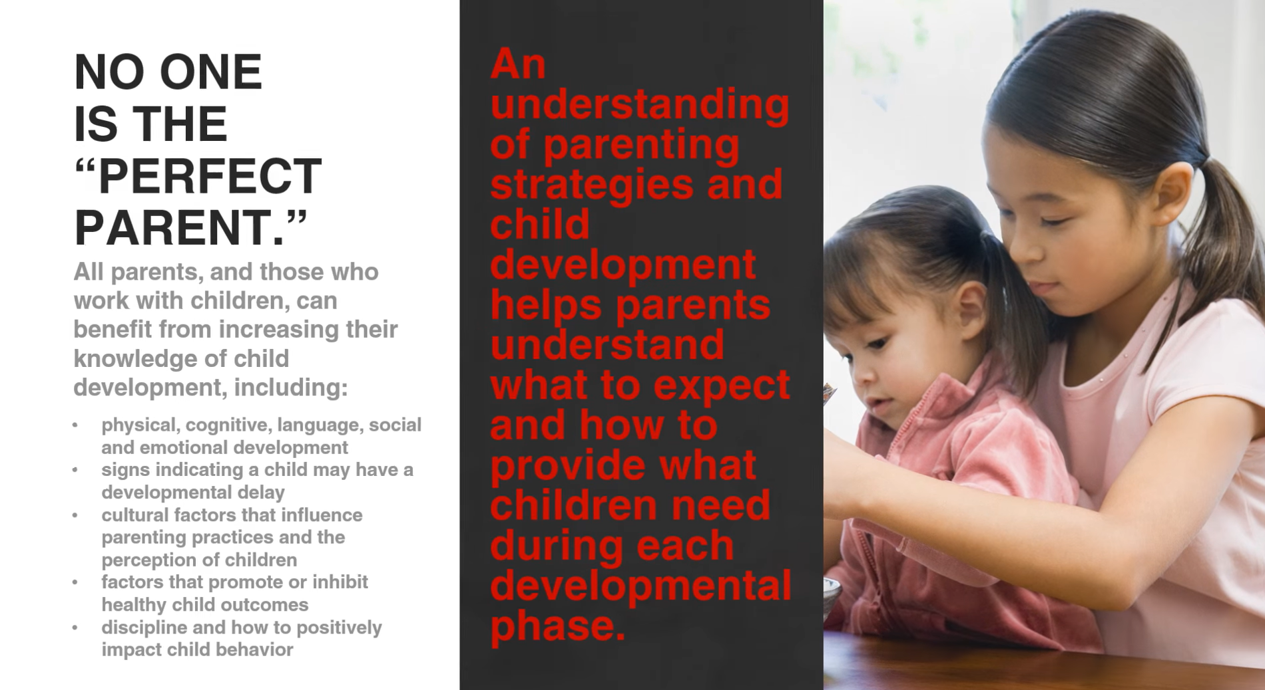

Slide 24
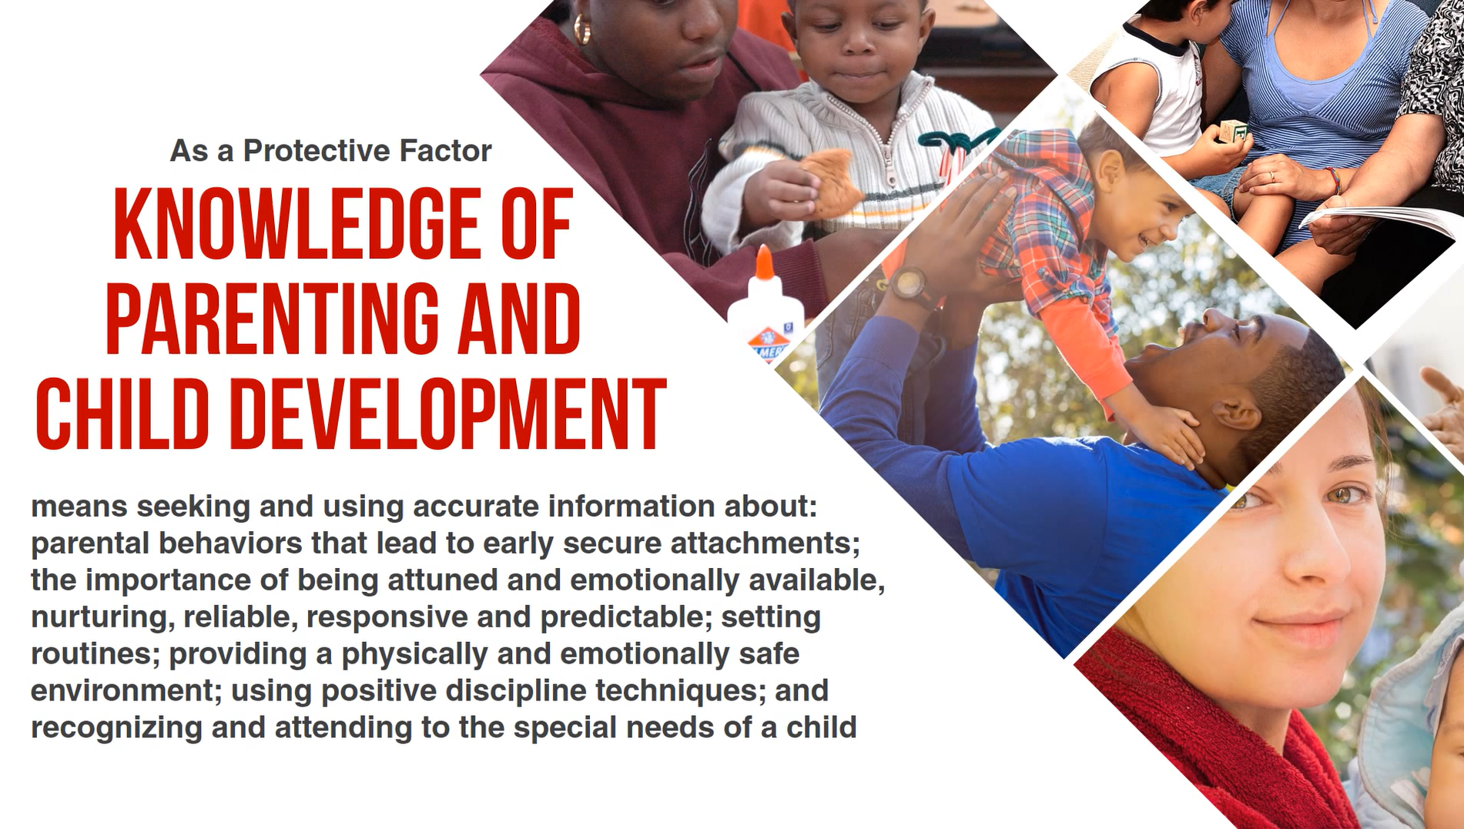

Slide 25
Knowledge of Parenting & Child Development
Everyday Actions
Model developmentally appropriate interactions with children
Provide information and resources on parenting and child development
Encourage parents to observe, ask questions, explore parenting issues and try out new strategies
Address parenting issues from a strength-based perspective

Slide 26


Slide 27
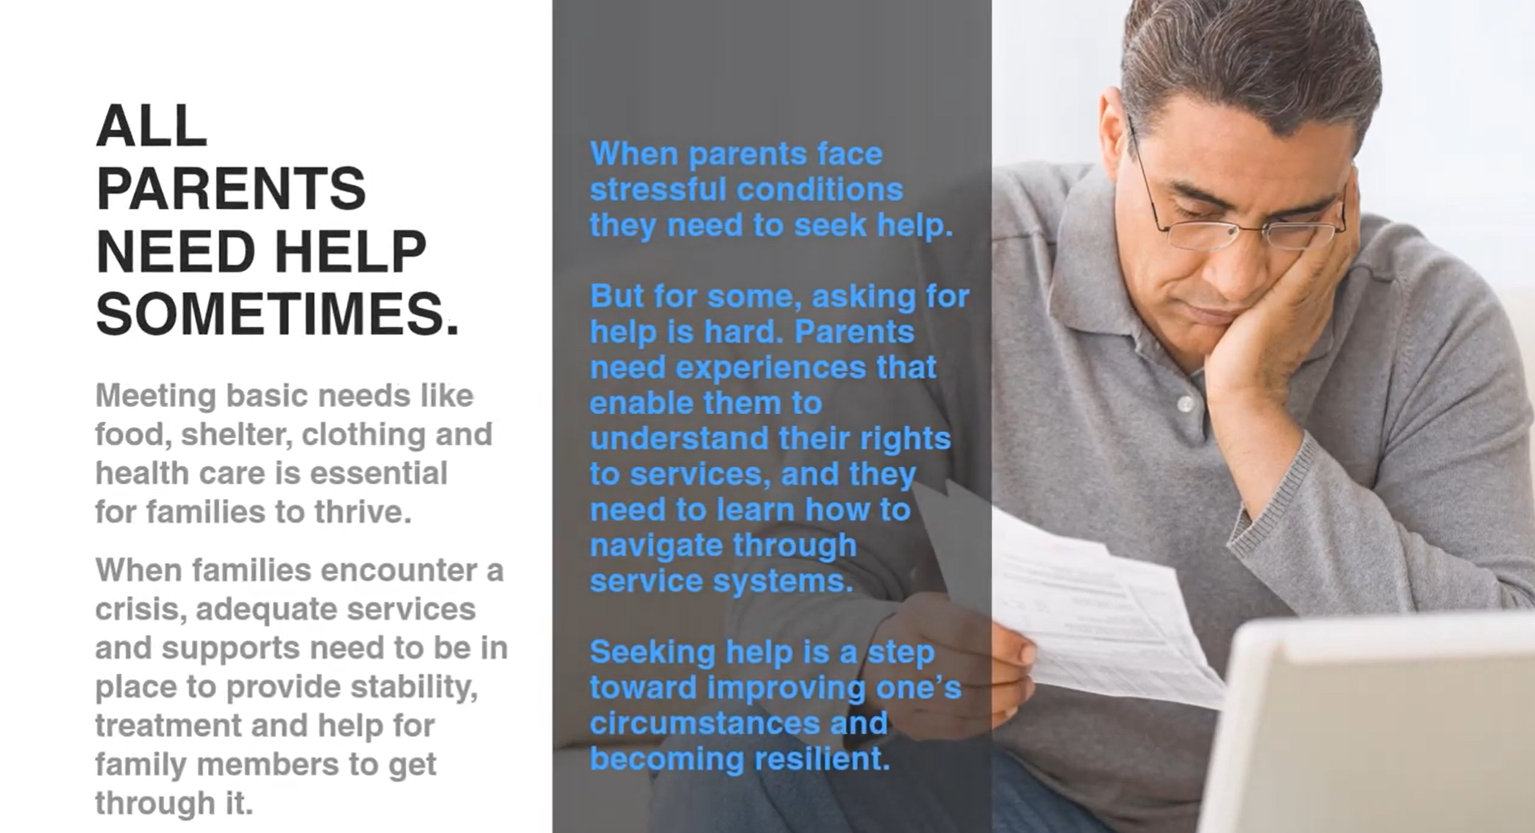

Slide 28


Slide 29
Concrete Supports in Times of Need
Everyday Actions
Respond immediately when families are in crisis
Provide information and connections to services in the community
Help families to develop skills and tools they need to identify their needs and connect to supports

Slide 30
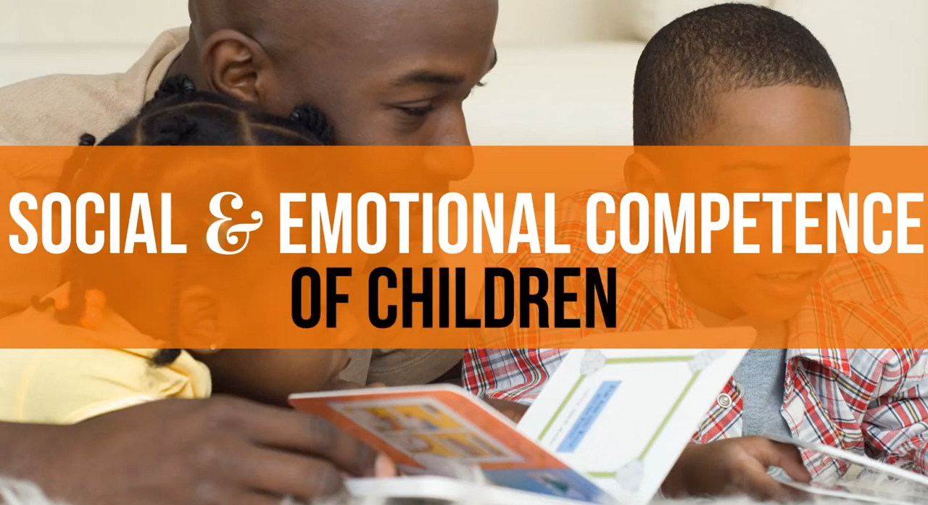

Slide 31
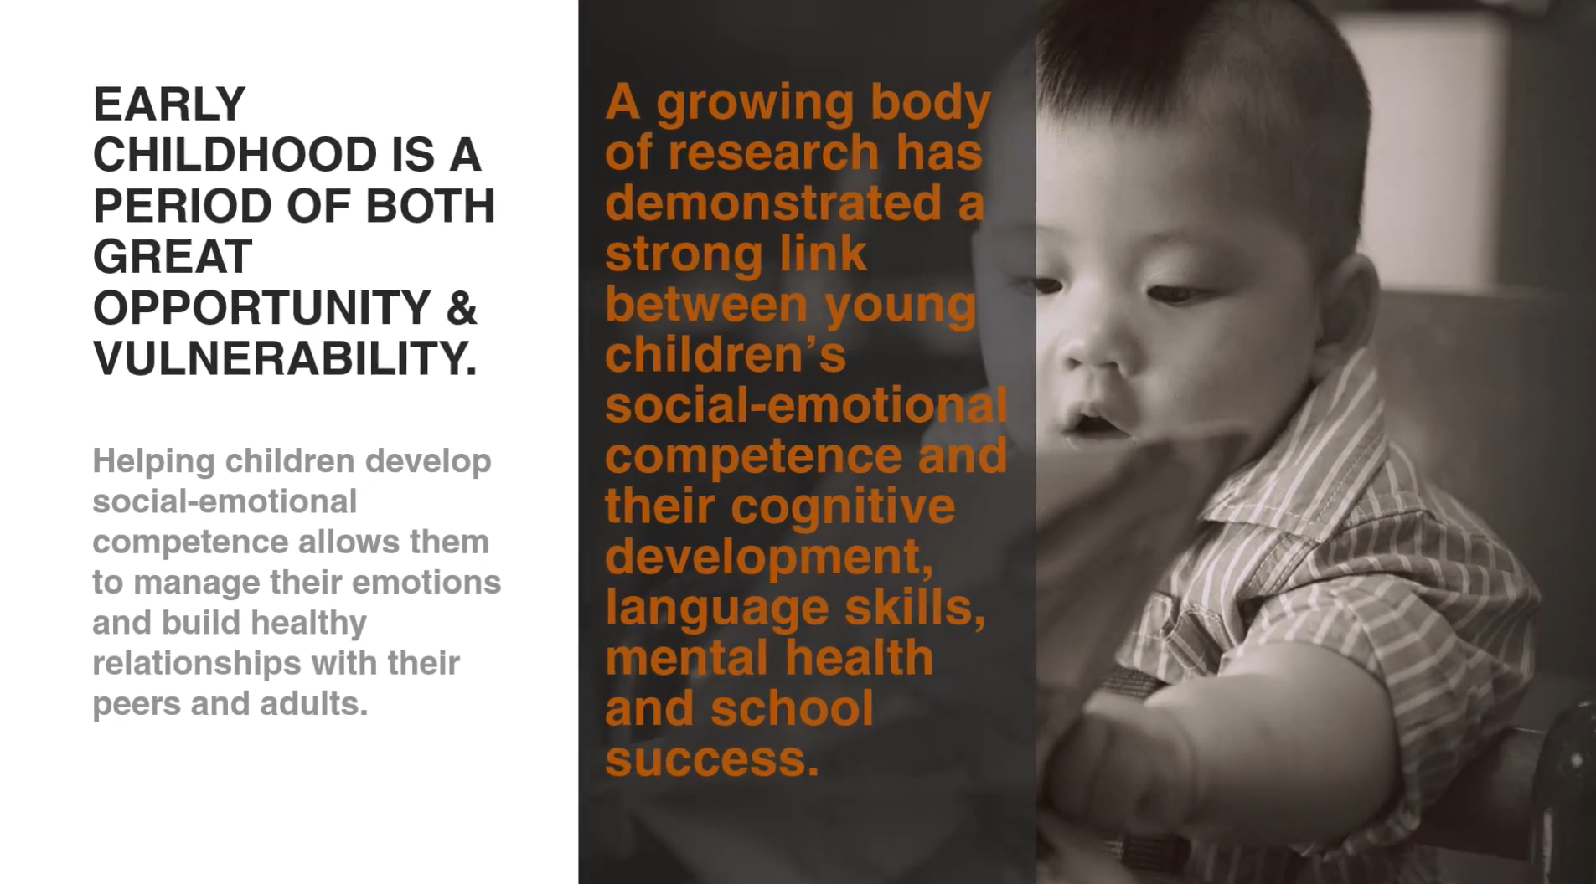

Slide 32
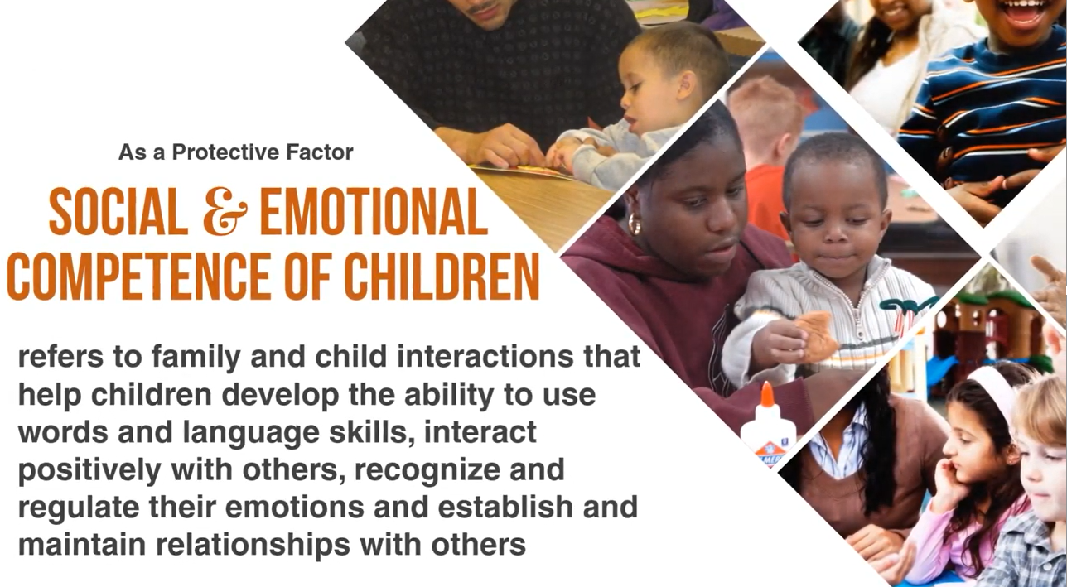

Slide 33
Social & Emotional Competence of Children
Everyday Actions
Help parents foster their child’s social emotional development
Model nurturing care to children
Include children’s social and emotional development activities in programming
Help children develop a positive cultural identity and interact in a diverse society
Respond proactively when social or emotional development needs extra support

Slide 34
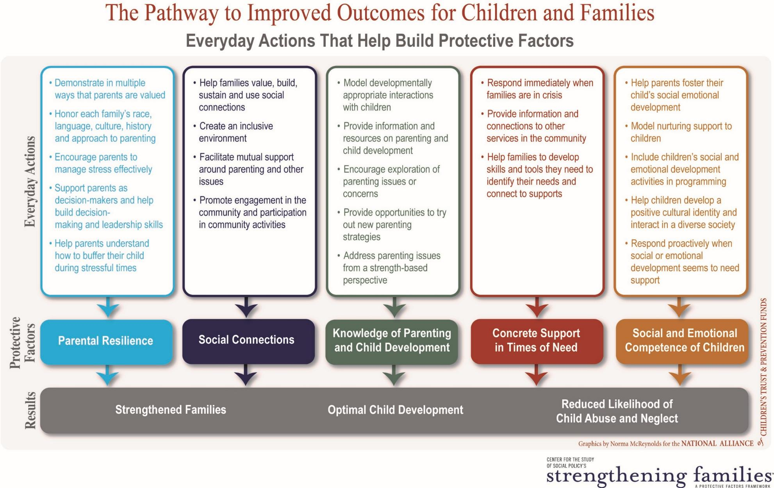

Slide 35
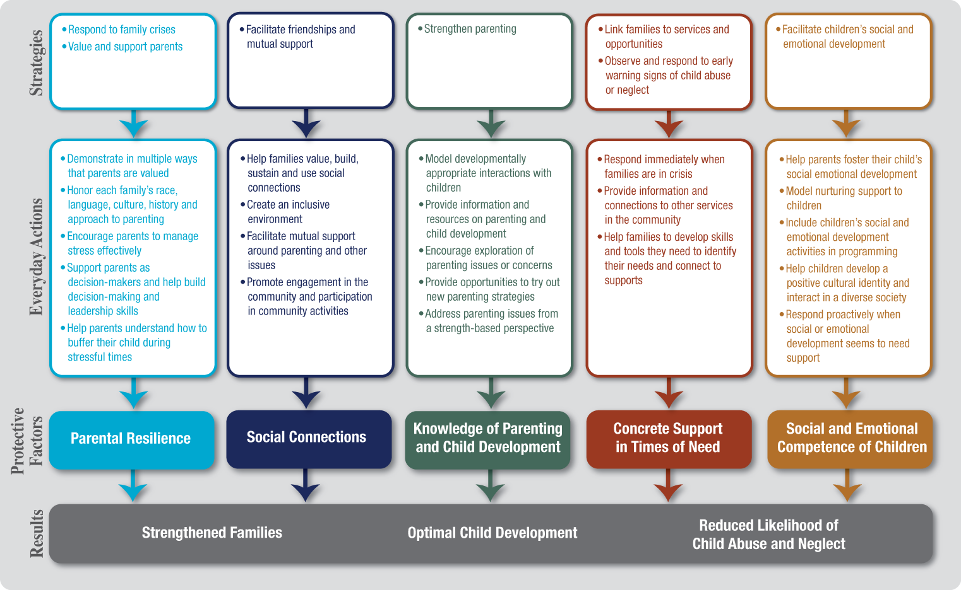
Which one of the Protective Factors do you connect with?
Which one of the Protective Factors do you want to know more about?

Slide 36
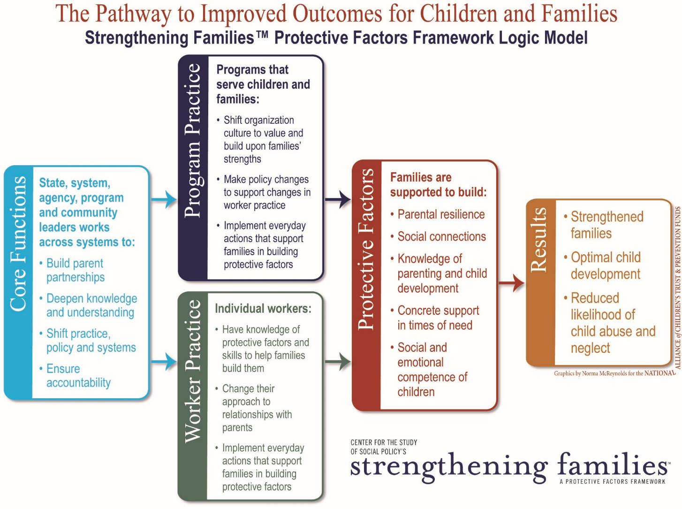

Slide 37
Social-Ecological Model and Protective Factors
Societal
(Policy)
Soci
Community
Relationship
Individual

Slide 38
What we know: Families gain what they need to be successful when key protective factors are robust in their lives and communities
CHAT
So, what needs to be present in a community for families to build Protective Factors and thrive? (and prevent child abuse and neglect)

Slide 39
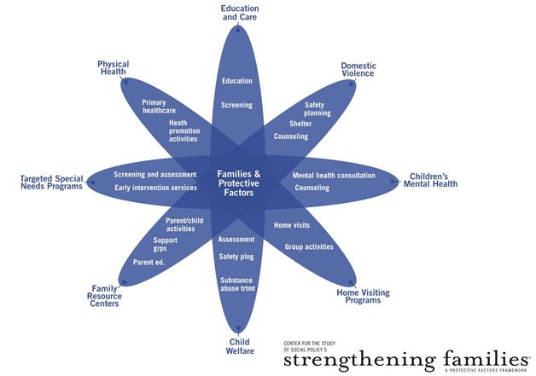
Policies
History
Community
Culture
Social Norms

Slide 40


Slide 41
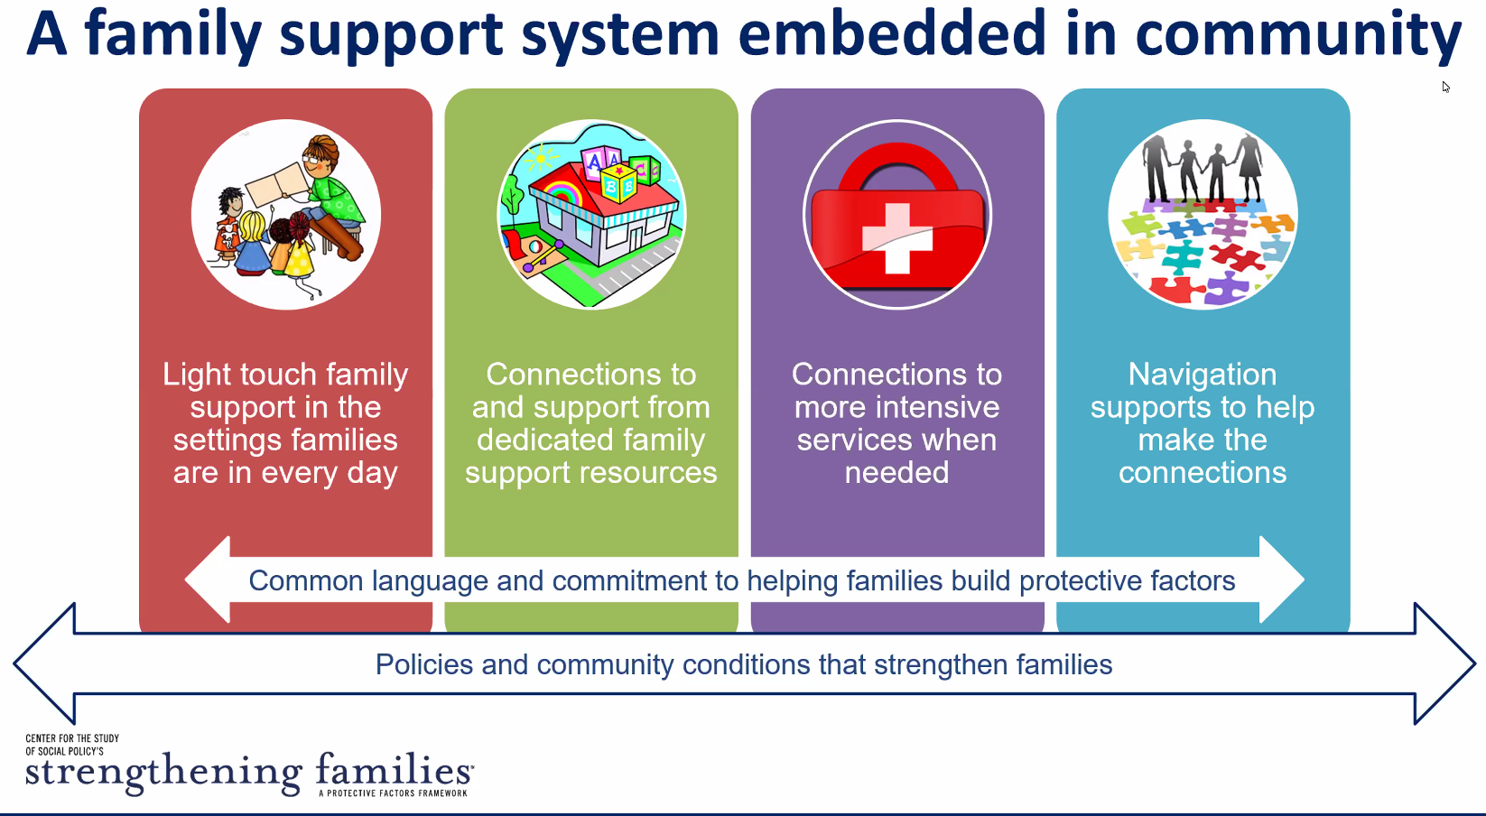

Slide 42
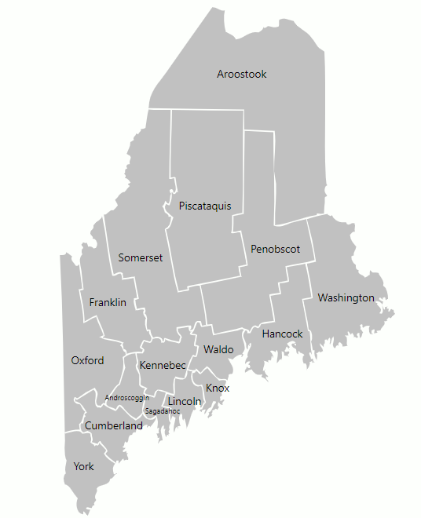
Maine Prevention Councils
The Prevention Councils use a structured approach using the Protective Factor Framework to build a system of support for local communities and families.
Integrates the Protective Factors into an annual needs assessment to identify needs and gaps
Service structure intentionally builds Protective Factors in annual prevention plans
Focus on primary and secondary child abuse prevention strategies and activities that build Protective Factors and supports for ALL families
Utilizes evidence-based and informed curriculums, supports, and evaluation that shows we have successfully build Protective Factors in families
Offer activities in response to unique county-specific needs as well as public awareness that builds community around the Protective Factors
Supported by the Maine Department of Health and Human Services

Slide 43
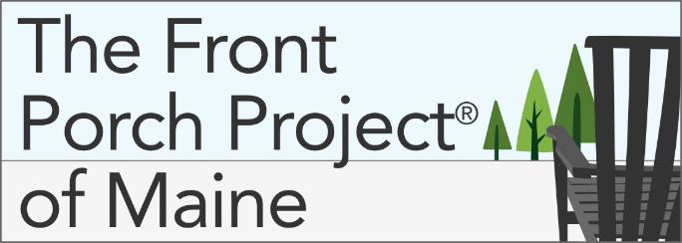
Launched in 2020, The Front Porch Project® of Maine is a primary prevention project. We know that community members who are equipped with the knowledge, skills, and encouragement they need can take an active role in protecting children and supporting families in their community. The goal is simple – to engage and train the community to help protect children, support families, and prevent abuse and neglect.
  Free training is provided by local Prevention Councils
  Provided both in person or virtually, and is open to everyone
  Offers facilitated discussions and interactive activities to navigate difficult situations involving children and families
  Provides strategies for offering families support

Slide 44

Tools to Support
Strengthening Families
Implementation

Slide 45
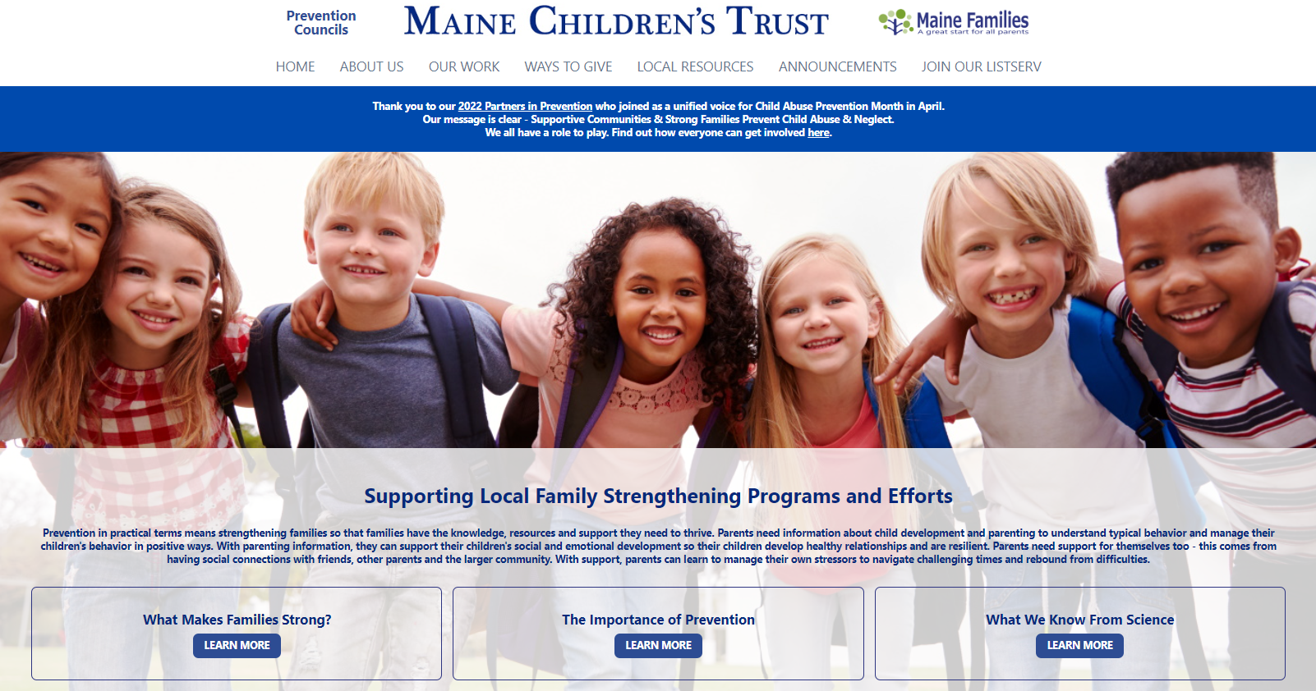
www.mechildrenstrust.org

Slide 46
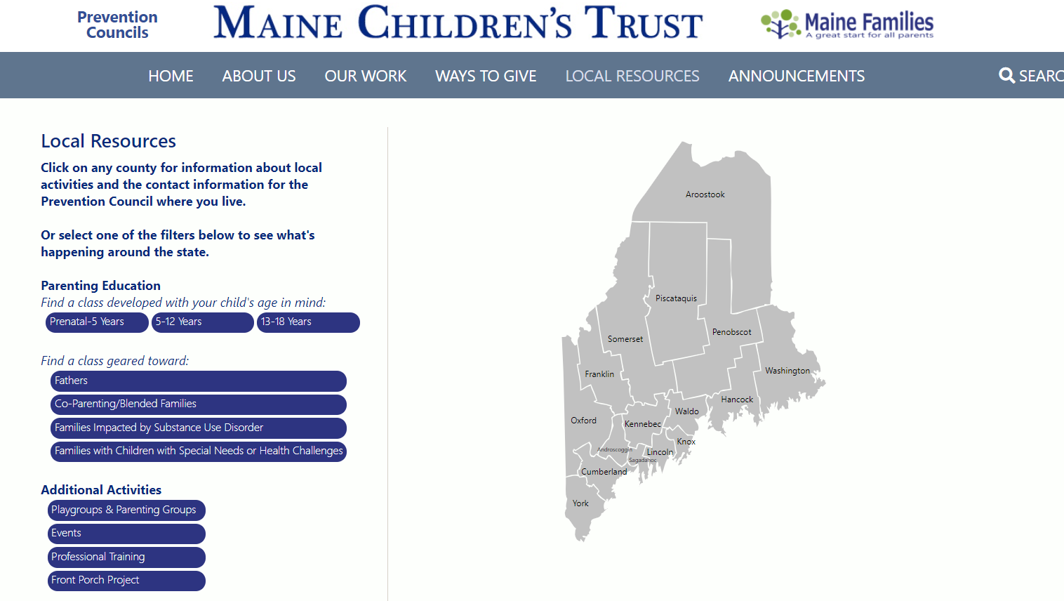

Slide 47
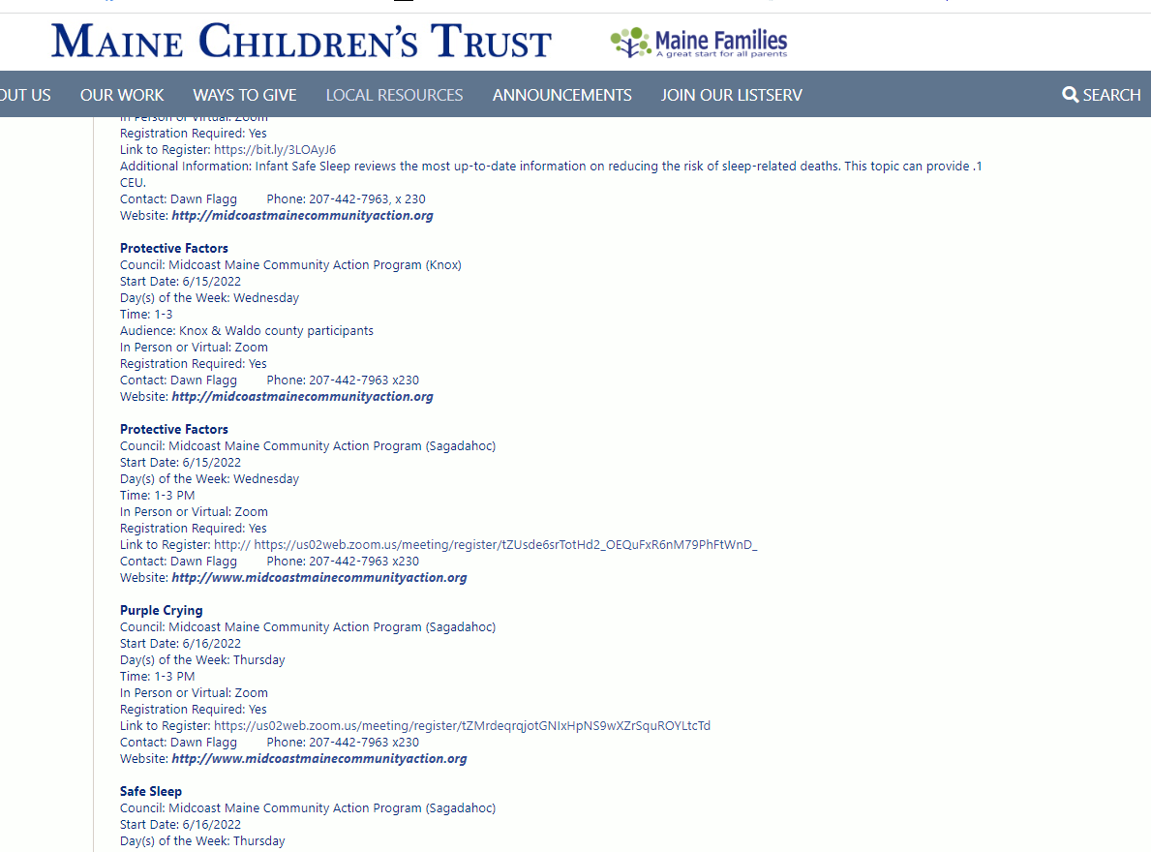

Slide 48
Center for the Study of Social Policy (CSSP) has developed materials to help support implementation and explain why building protective factors in families should be important to multiple disciplines including:
Early Childhood Education
Child Abuse Prevention
Child Welfare
Foster Parents
Kinship Providers
Community Based Family Serving Organizations
Businesses
Educators
Primary Health Partners

Slide 49
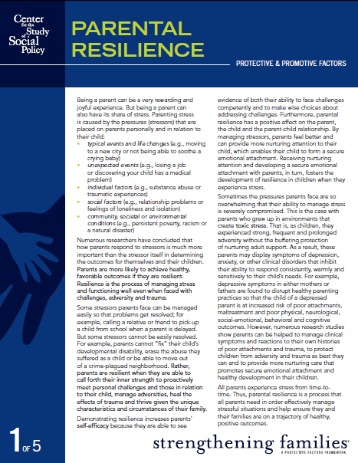
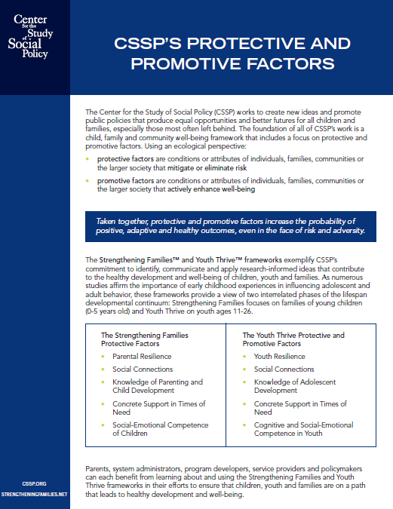
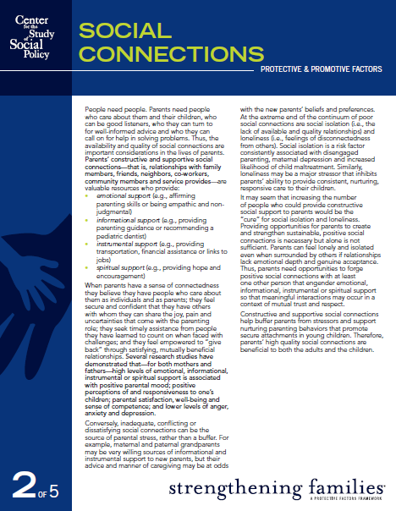
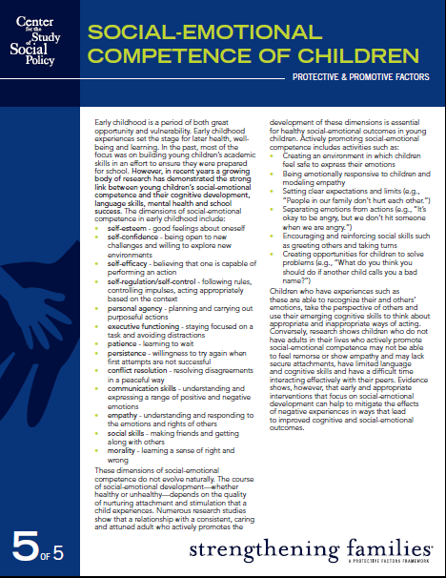
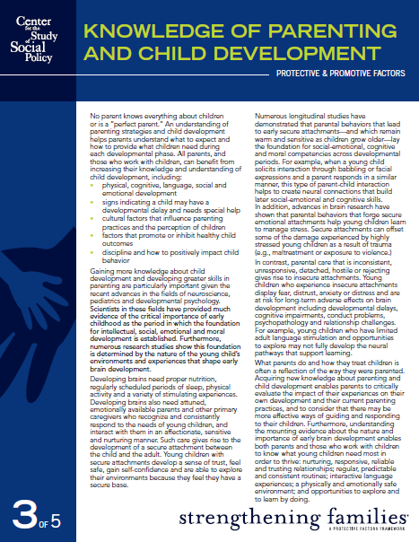
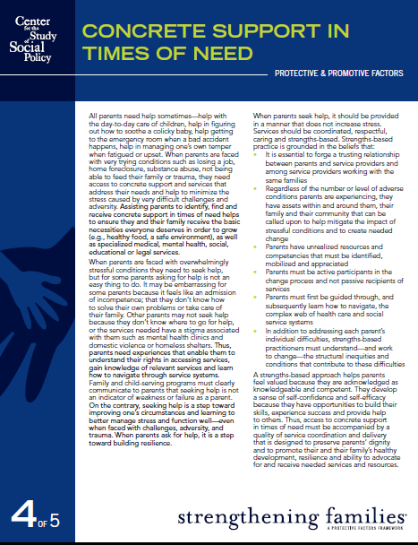

Slide 50
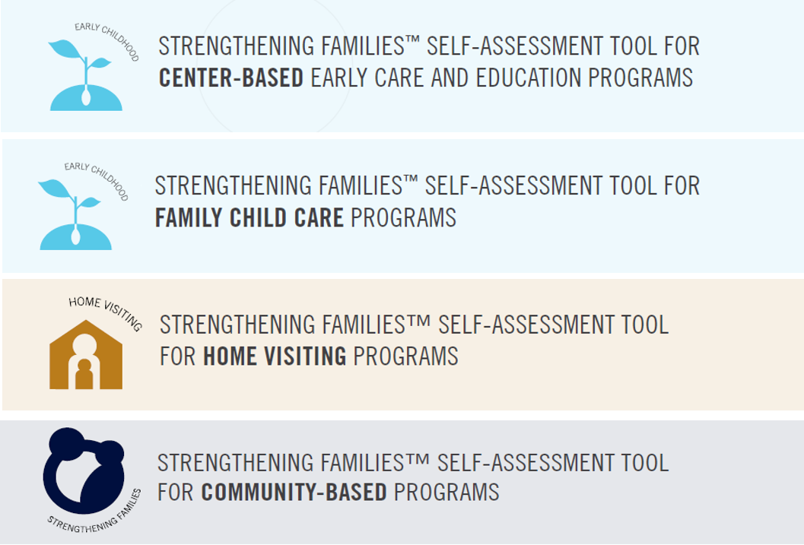
Four Program Self-Assessments

Slide 51
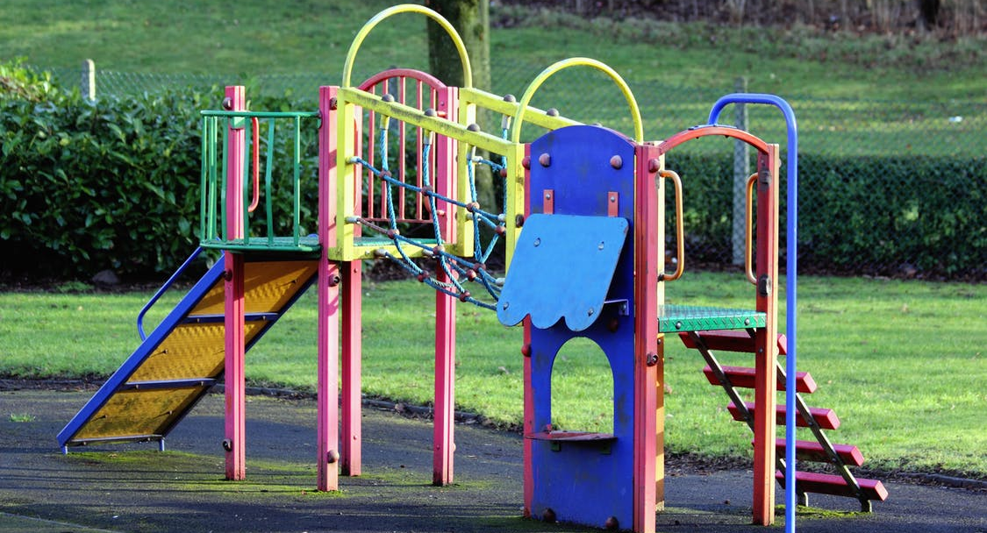
About the Self-Assessment
Key implementation tool for programs adopting a Protective Factor Approach for Strengthening Families
Helps programs identify “small but significant changes” that enhance their ability to build protective factors
Designed to be used flexibly and to lead you to a concrete action plan
Helps programs identify strengths & areas to focus
Not an evaluation tool but a tool for continuous improvement
Organized around the five protective factors and the everyday actions to help families build them.

Slide 52

Completing the Self-Assessment
Create a Self-Assessment team (administrators, practitioners, parents)
Fill-out the Self-Assessment individually
Convene to share and compare responses
Fill out a “group consensus” Self-Assessment

Slide 53
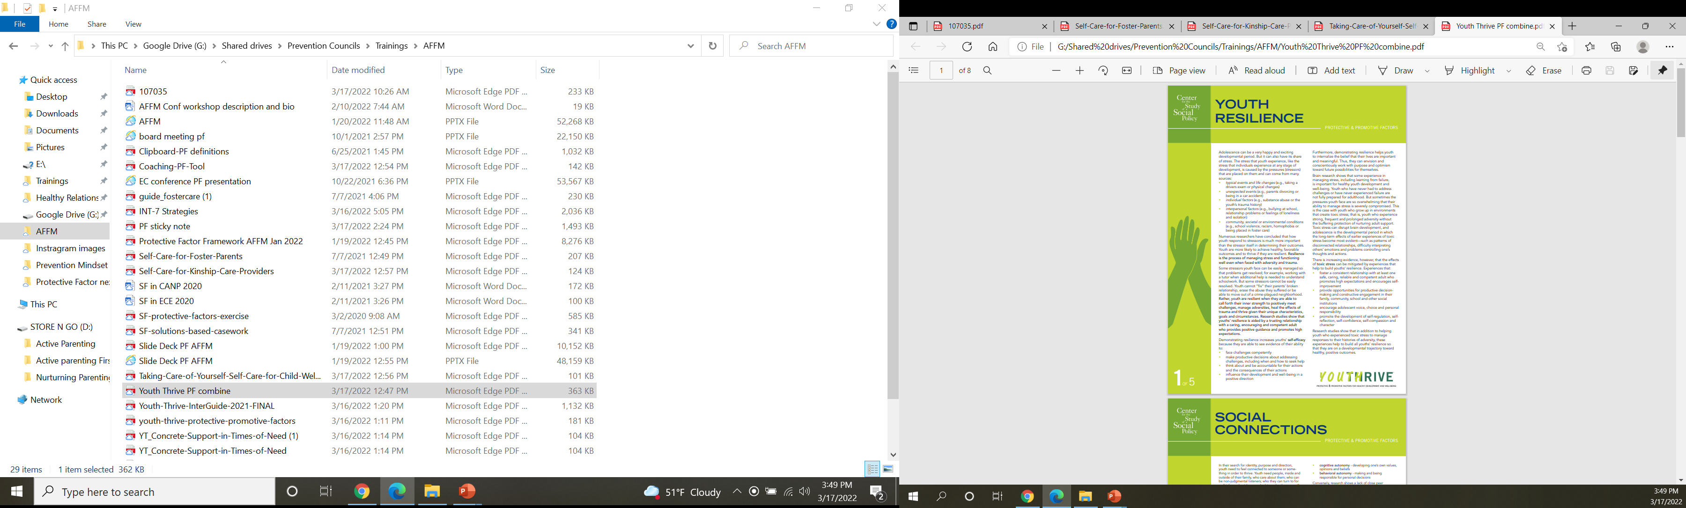

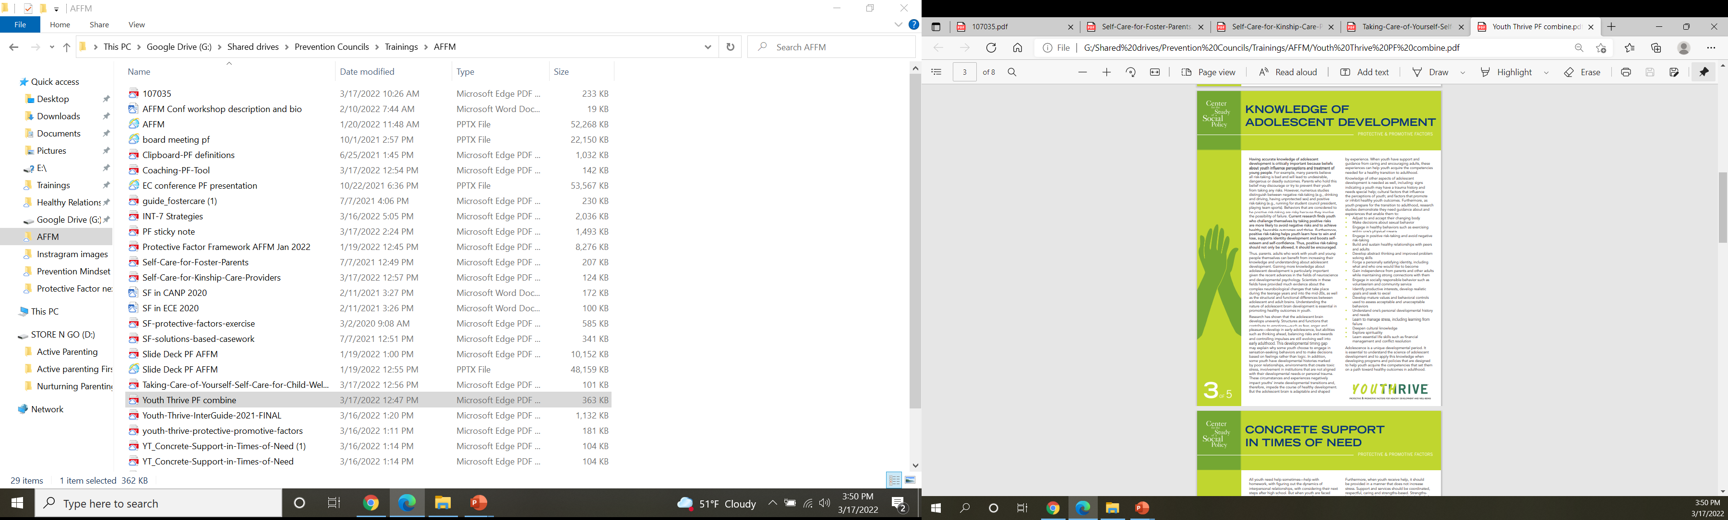
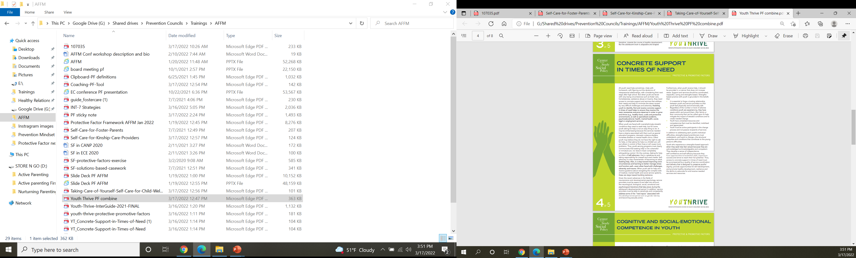
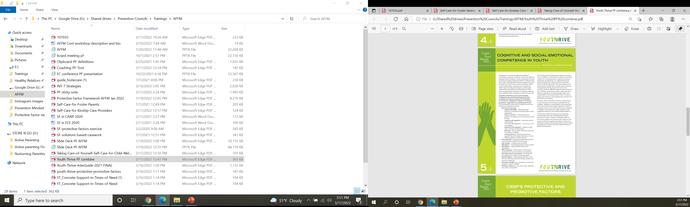

Slide 54
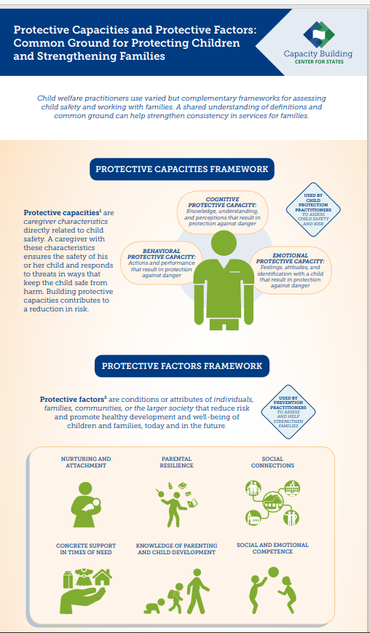
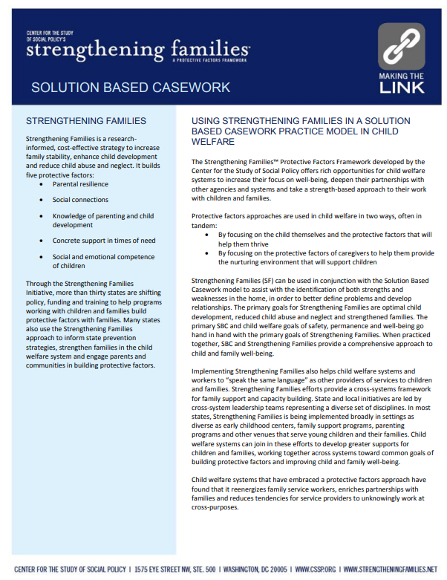

Slide 55
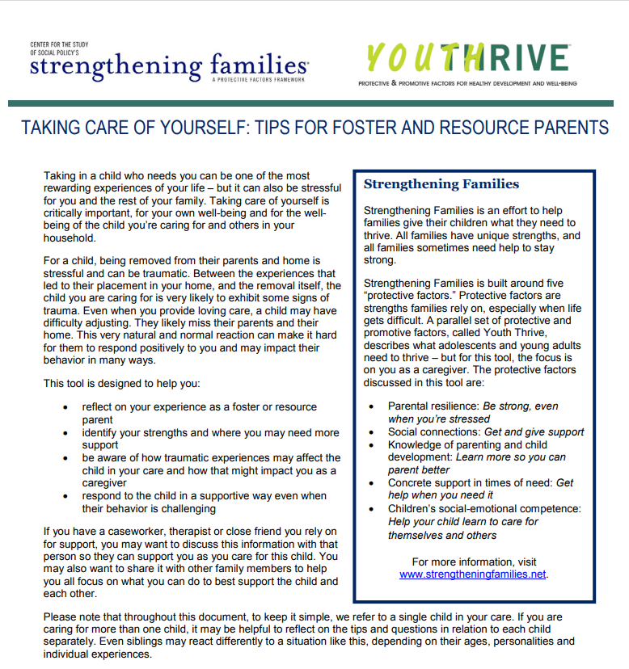
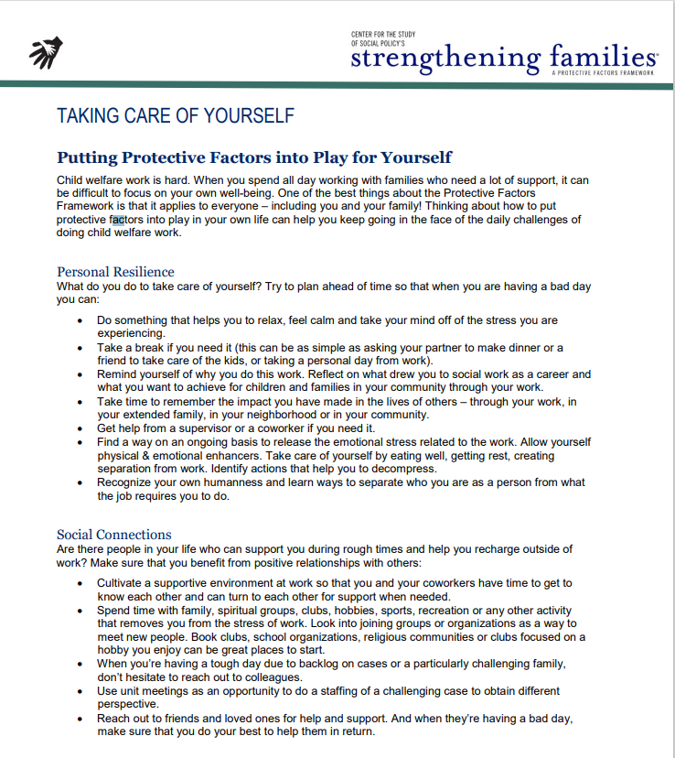
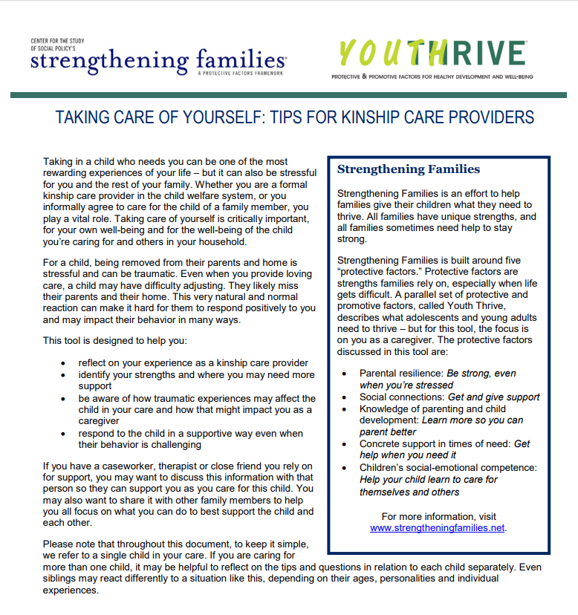

Slide 56


Thank you!
Denise Trafton, LSW
Prevention Support Specialist
deniset@mechildrenstrust.org
(207) 623-5120
Heidi Aakjer, MPA
Assistant Director &
Prevention Coordinator
heidia@mechildrenstrust.org
(207) 623-5120
Christine Theriault, LMSW
Family First Prevention Services
Program Manager
Office of Child and Family Services
Christine.Theriault@maine.gov
(207) 624-7914
www.maine.gov/dhhs/ocfs
www.mechildrenstrust.org
MaineChildrensTrust
mechildrenstrust

